Slide 1
Wifi hacking
Alexandr Tsvetkov

Slide 2
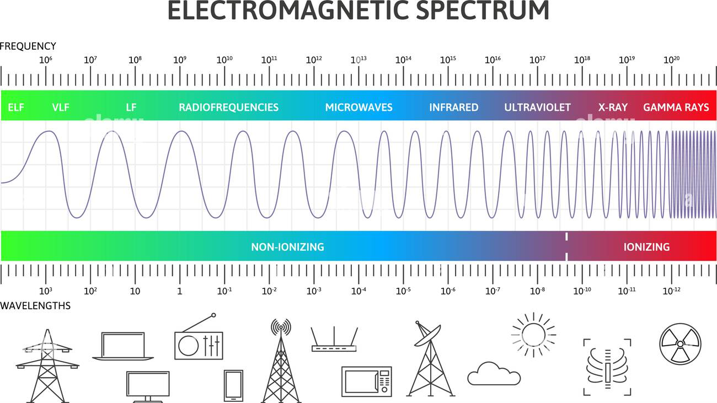

Slide 3


Slide 4


